Slide 1

ARDUINO CODING PROJECT
BY WILLIAM SOPER, MONTY VILLEGAS VERSCHOYLE, DANIEL ARANDA, DARNELL FORD

Slide 2

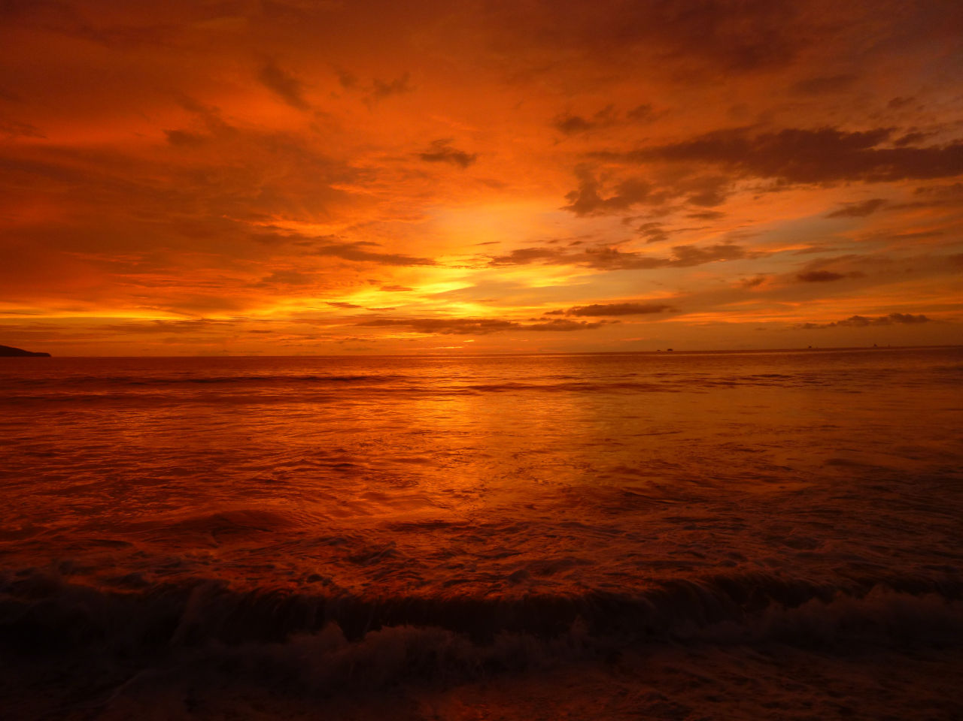
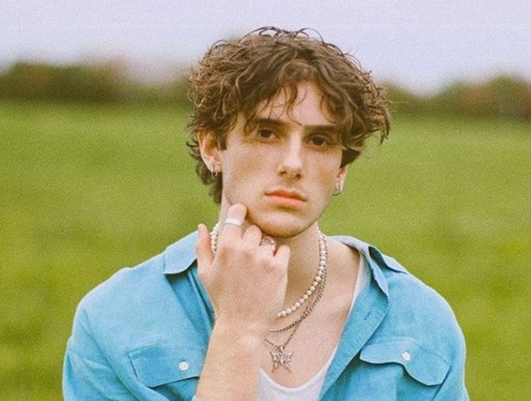
SONG CHOICE

Slide 3
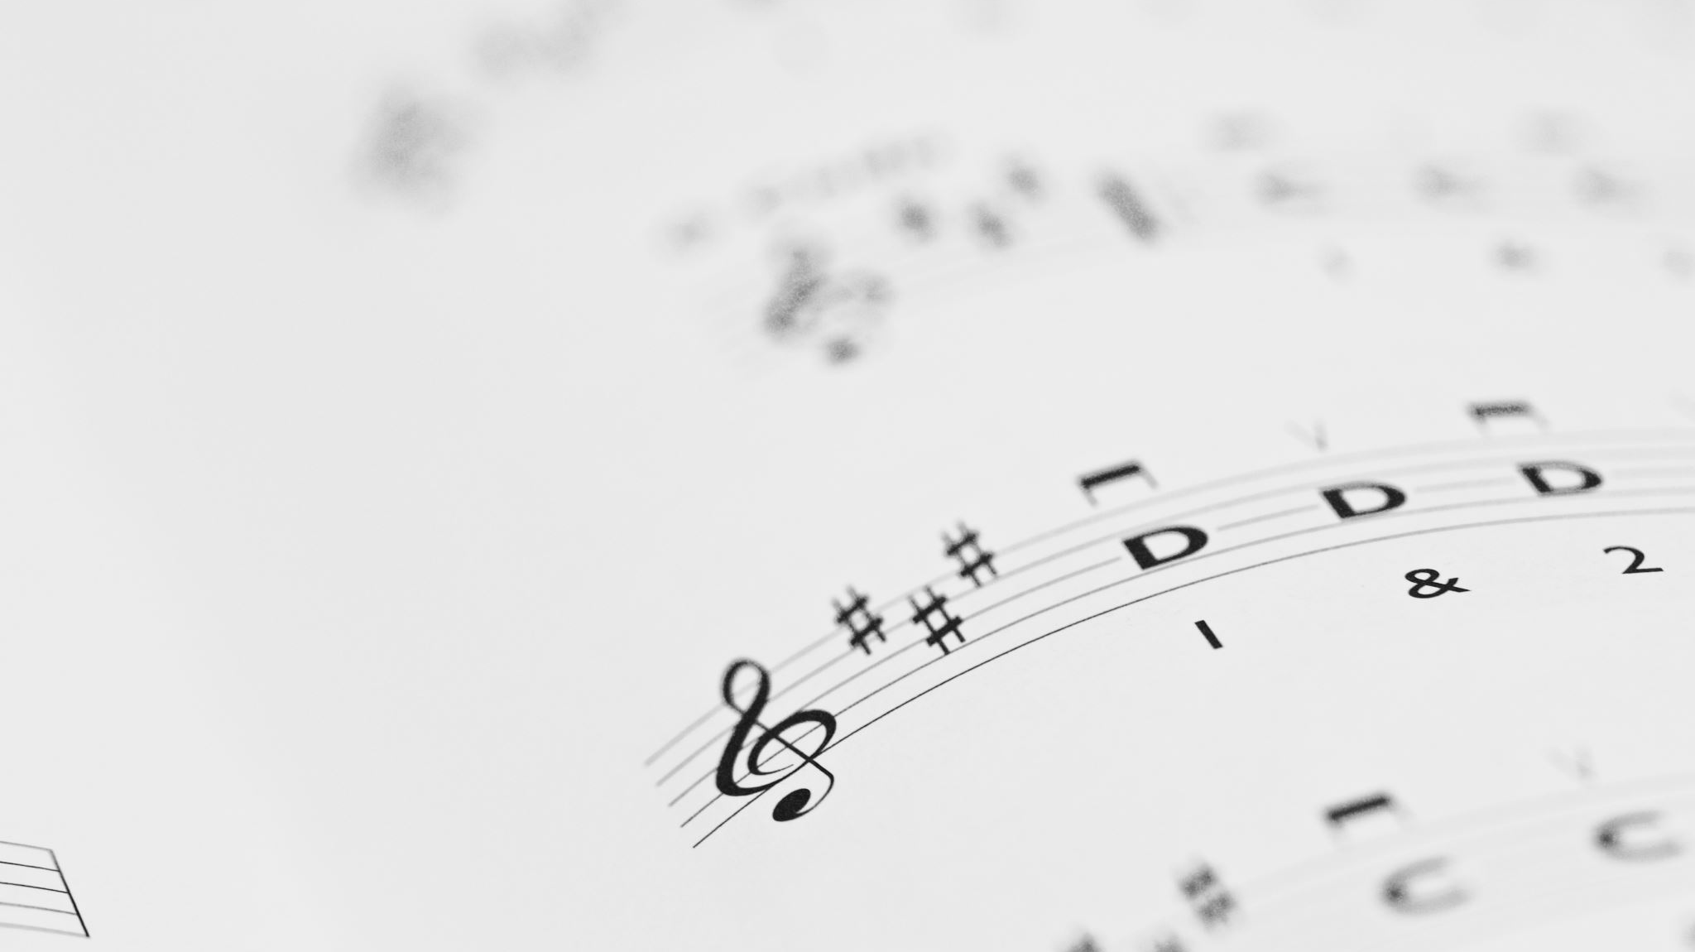
Song Background
JVKE says that the composition of the piano in the song was heavily influence by Franz Liszt, who is an 1800s composer whose music he played while being classically instructed in piano.
He had written the song to be about falling in love, illustrated by the first few lines of the song.
JVKE wrote and produced "Golden Hour" with his brother, Zac Lawson.
The website used as a reference to transcribe the sheet music was, “https://musicsheets.org/golden-hour/”

Slide 4
The Code

Slide 5


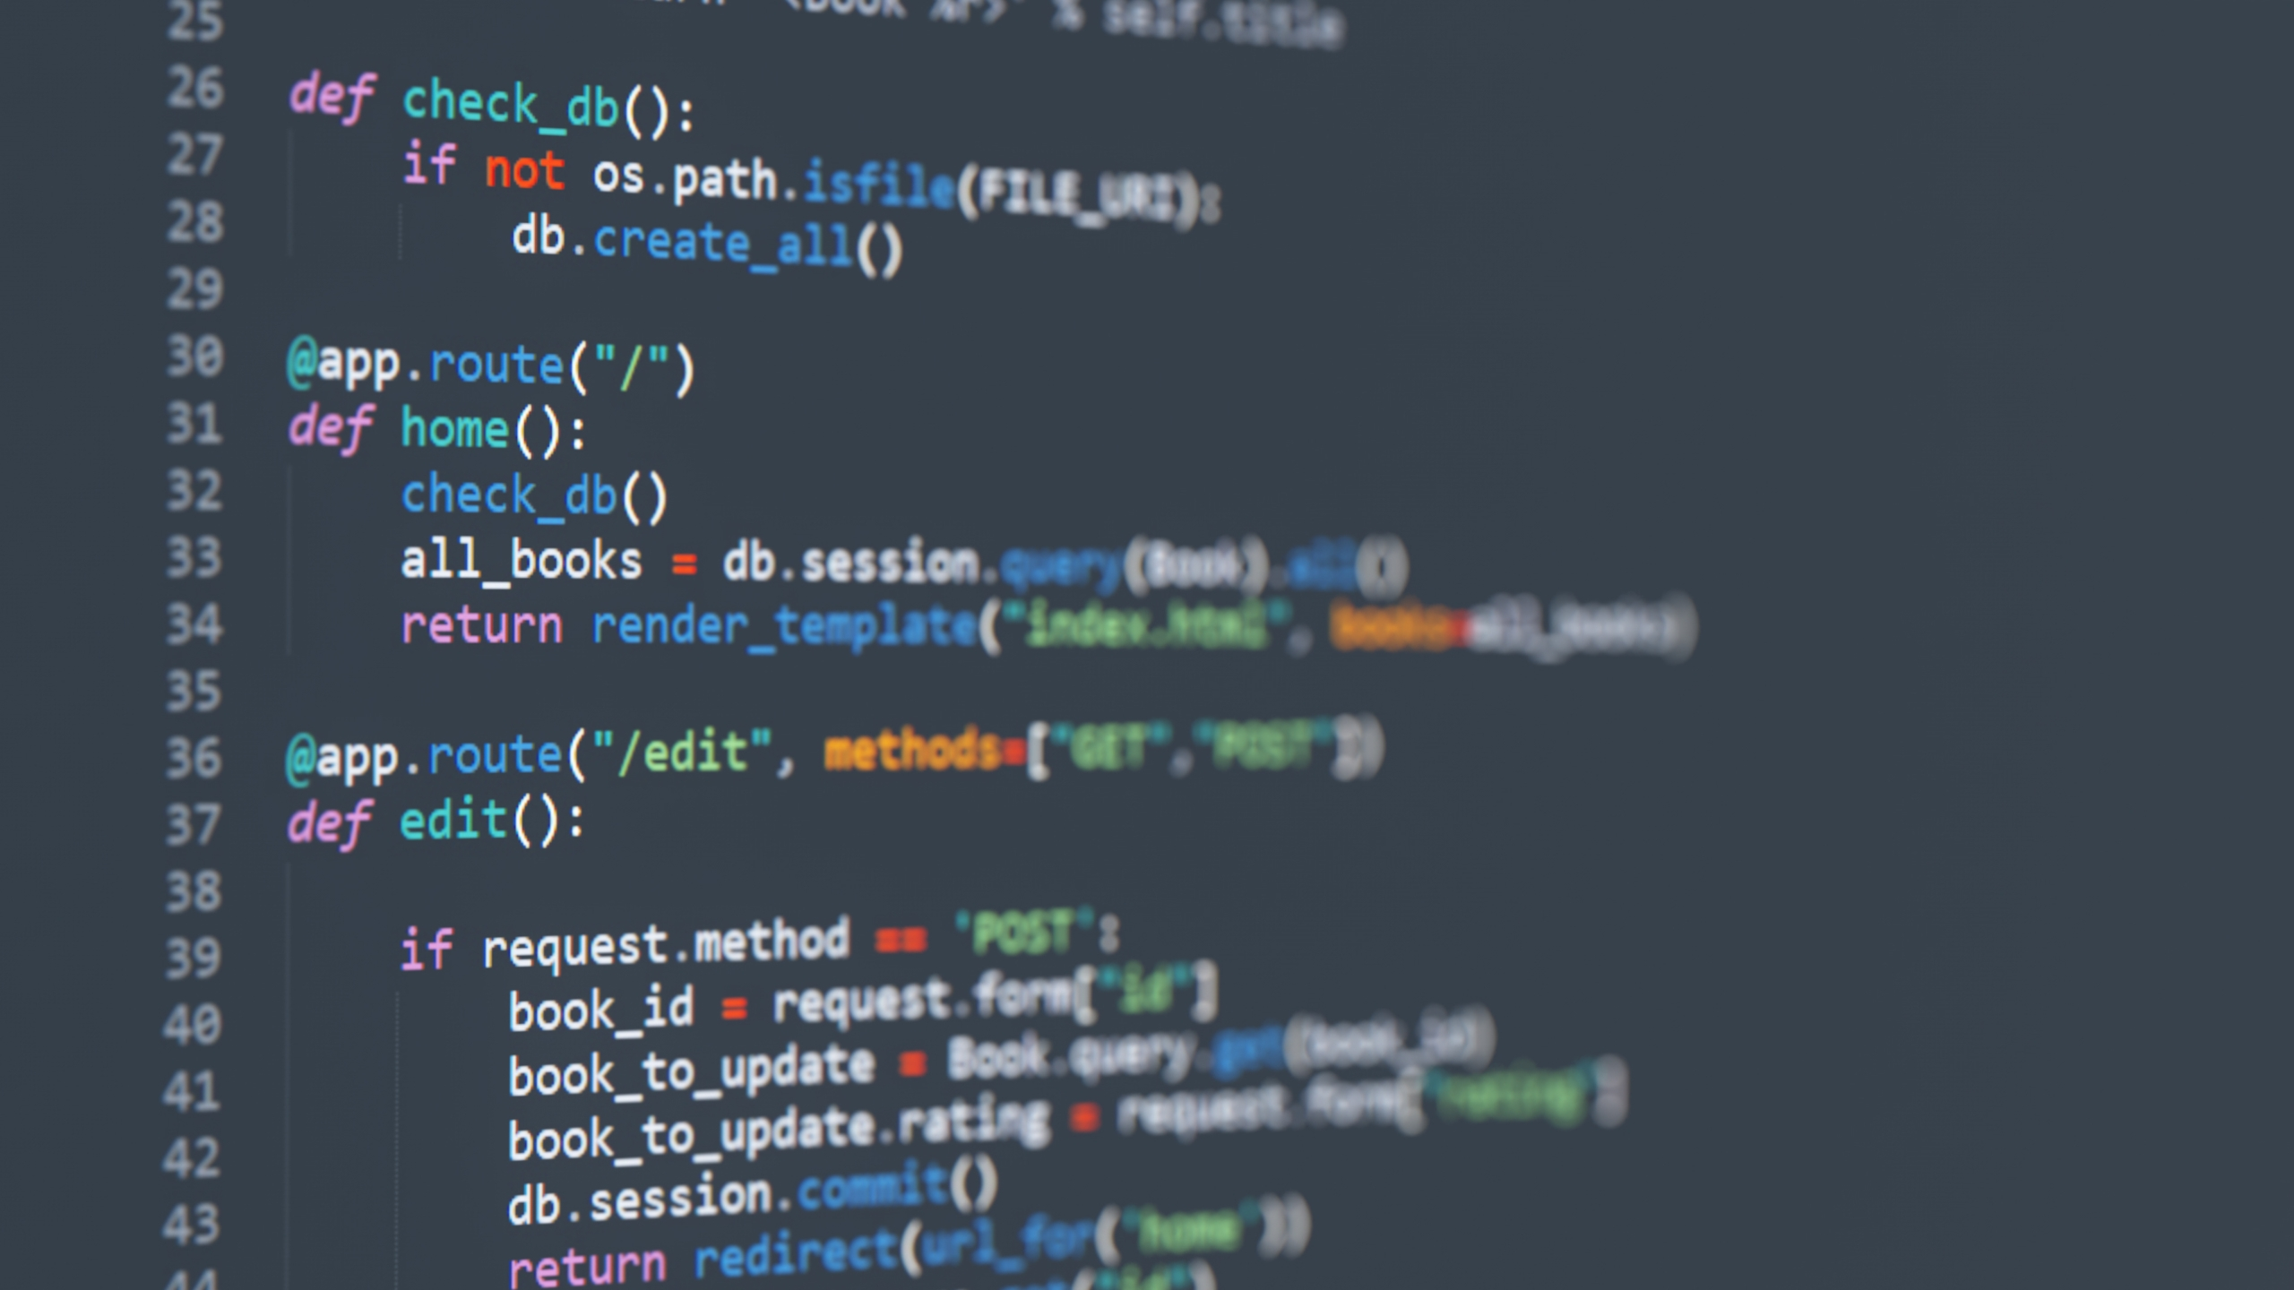
Roles
Monty Villegas Verschoyle: Main code builder, Presentation editor, Quartermaster
William Soper: Presentation builder, Translator, Presentation editor
Darnell Ford: Translator, Presentation builder, Code editor
Daniel Aranda: Presentation builder, Rehearsal, Translator

Slide 6
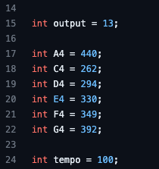
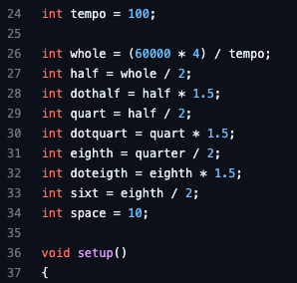
Variables

Slide 7
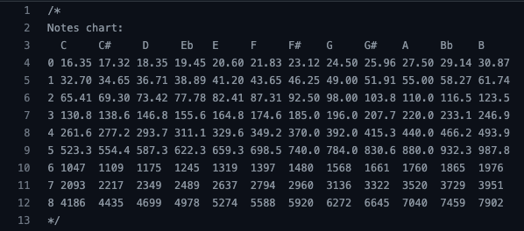
Tones & Frequencies

